Slide 1








Emoji Prediction using LSTM
Department of Electronics and Communication Engineering
- RAKSHITA GOWDA (03)
1

Slide 2
Contents:
Introduction
Machine Learning Basics
Introduction to Deep Learning
LSTM Algorithm
Flowchart
Advantages, Disadvantages, Future Scope
Conclusion
References

Slide 3

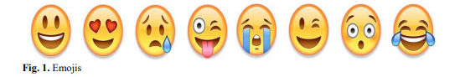
Introduction
The emojis are tiny graphics, generally used during texting through social media platforms.
These express a combination of visuals and words simultaneously and provide a different method of interactions.
Even after being used quite a significant number of times on social media, their meanings and importance haven't received enough focus and attention.
In the described project, we perform the analysis of the relationship between emojis and English words and predict the respective emojis for some given text or tweet messages.

Slide 4
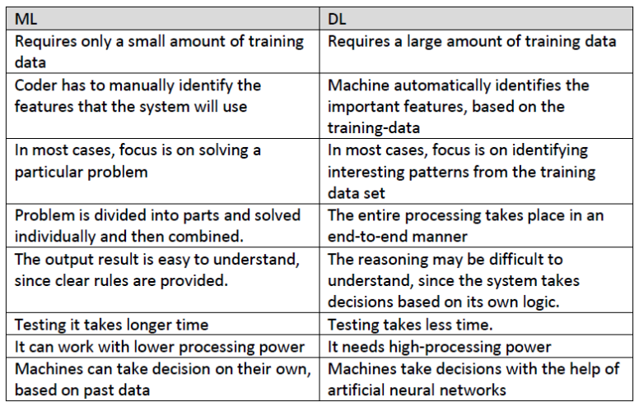
Difference between DL and ML
4

Slide 5
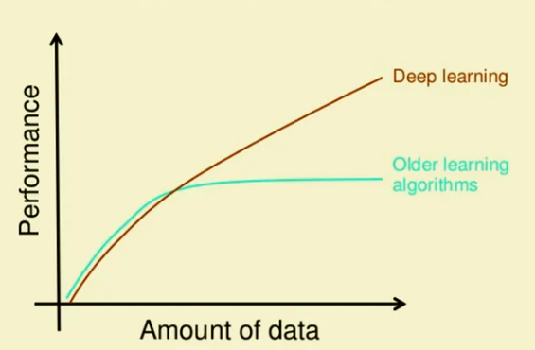
Why Deep Learning?
Deep learning is a subfield of machine learning that has gained tremendous popularity and proven to be highly effective in a wide range of applications.
There are several compelling reasons why deep learning is preferred and used extensively:
- Ability to Learn Complex Patterns
- Feature Extraction
- Scalability
- Versatility
- State-of-the-Art Performance
- Transfer Learning
- Representation Learning
- Continuous Improvement
- Availability of Frameworks and Libraries
- Real-world Applications
5

Slide 6
LSTM Algorithm
Long Short-Term Memory (LSTM) networks are a type of recurrent neural network useful for predicting sequences.
Bi-Directional Long Short-Term Memory (Bi-LSTM) is a type of recurrent neural network (RNN) with two separate layers of neurons, one running the input sequence forwards and another running it backwards.
It allows the network to capture contextual information from both directions in the input sequence, allowing it to understand the data better and make better predictions.
The Bi-Directional architecture can also improve the performance of language models, especially for tasks like sentiment analysis.
Bi-LSTMs are a powerful tool for natural language processing (NLP) and have been used in many applications such as voice recognition, machine translation, and question answering.
6

Slide 7
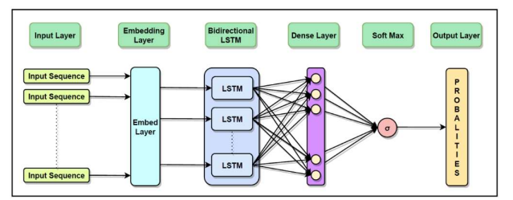
Implementation Plan:
Flowchart of LSTM Network
7

Slide 8
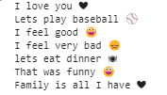
Result:
The results of using a Bi-Directional LSTM for emoji prediction are promising.
The model achieved an accuracy of 94%, showing that the model was able to predict an emoji based on the preceding text with high precision.
Further, the model predicted a larger variety of emojis, which is beneficial for applications like sentiment analysis.
8

Slide 9
Advantages:
Enhanced Communication
User Engagement
Automated Expression
Contextual Understanding
Data Dependency
Interpretability
Cultural and Contextual Variations
Evolution of Emoji Usage
Disadvantages:
Multilingual Support
Real-time Contextual Analysis
Integration in Virtual Assistants
Cross-modal Applications
Future Scopes:
9

Slide 10
Conclusion
The Emoji Prediction project was successfully implemented, achieving the goal of associating emojis with sentences using machine learning libraries.
The project started with a data-driven approach, collecting and preprocessing a substantial dataset of sentences with emojis sourced from Twitter messages.
Feature extraction and embedding techniques were applied to convert textual data into a format suitable for machine learning models, enhancing the model's understanding of sentence semantics.
The project explored and integrated Long Short-Term Memory (LSTM) models, providing insights into handling sequential data and enriching the project's capabilities.
The outcome is a practical Emoji Prediction system that can suggest emojis based on input sentences, showcasing the tangible application of machine learning in enhancing communication and expression.
10

Slide 11
References
Vinayak Sudhakar Kone, June 2023, “Emoji Prediction Using Bi-Directional LSTM”, ITM Web of Conferences
Digital 2023 Global Overview Report, https://datareportal.com/reports/digital-2023-global-overview-report
Ranjan, Ritwik, and Palak Yadav. "Emoji Prediction using LSTM and Naive Bayes”, TENCON 2021-2021 IEEE Region 10 Conference (TENCON). IEEE, 2021
Peng, Dunlu, and Huimin Zhao. "Seq2Emoji: A hybrid sequence generation model for short text emoji prediction." Knowledge-Based Systems 214 (2021): 106727.
Acheampong, Francisca Adoma, Chen Wenyu, and Henry Nunoo‐Mensah. "Text‐based emotion detection: Advances, challenges, and opportunities." Engineering Reports 2.7(2020)
11

Slide 12
THANK YOU
- RAKSHITA GOWDA (03)

